Slide 1


SAL COLLEGE AND ENGINEERING
Analysis and Design of Algorithms–(BE04000241) SEM – 4 B Branch – Computer Engineering
Greedy Algorithm
Presented by
Sr. No | Enrollment No | Student Name
1 | 251133107016 | MAHERIYA HARDIK S
Submitted to Prof. Twinkle Patel

Slide 2
Introduction to Greedy Algorithm
A Greedy Algorithm is an algorithmic strategy that builds a solution step by step by choosing the best option available at the current moment.
It selects the locally optimal choice at each step.
The goal is to reach a globally optimal solution.
Used mainly for optimization problems.
Example idea:
Always take the best immediate benefit.

Slide 3
Key Idea of Greedy Algorithms
The greedy approach works by repeatedly making the best choice at the moment without re-considering previous decisions.
Main concept:
Local optimum → hope to reach global optimum.
Example analogy:
Selecting highest value coin first in coin change problem.

Slide 4
Characteristics of Greedy Algorithms
Greedy algorithms usually have these properties:
Greedy Choice Property
  The best local choice leads to the optimal solution.
Optimal Substructure
  Optimal solution can be constructed from optimal solutions of subproblems.

Slide 5
General Structure of Greedy Algorithm
Greedy algorithms follow a simple structure:
Initialize solution set
Choose the best candidate
Add candidate to solution
Repeat until solution is complete
Instead of checking all possible combinations, the algorithm focuses only on the best choice at each step.

Slide 6
Applications of Greedy Algorithms
Greedy algorithms are used in many well-known problems:
Activity Selection Problem
Fractional Knapsack
Minimum Spanning Tree
  Kruskal’s Algorithm
  Prim’s Algorithm
Huffman Coding
Dijkstra’s Shortest Path
They are commonly used in optimization and scheduling problems.

Slide 7
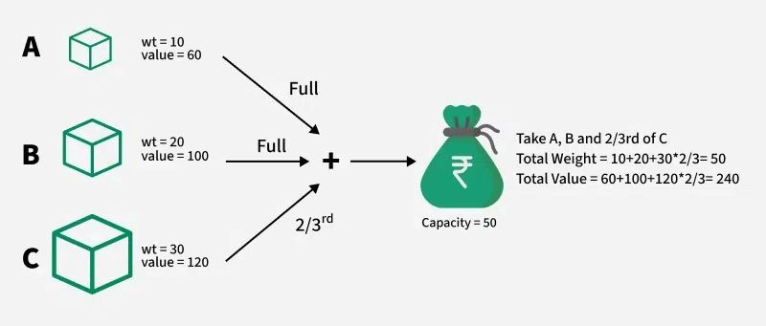
Fractional Knapsack Problem
Problem statement:
Given:
Items with value and weight
A knapsack with limited capacity
Goal:
Maximize the total value inside the knapsack.
In Fractional Knapsack, items can be broken into fractions to maximize value.

Slide 8
Greedy Approach for Fractional Knapsack
Steps:
Calculate value/weight ratio for each item.
Sort items based on highest ratio.
Pick items with highest ratio first.
If the next item doesn't fit completely, take fraction of it.
This ensures maximum profit in the knapsack.

Slide 9
Example of Fractional Knapsack
Item | Weight | Value | Ratio
1 | 10 | 60 | 6
2 | 20 | 100 | 5
3 | 30 | 120 | 4
Steps:
Select item with highest ratio first.
Continue until capacity is full.
Result → Maximum possible value.

Slide 10
Advantages of Greedy Algorithm
Advantages:
Simple to understand
Easy to implement
Efficient for many optimization problems
Often faster than dynamic programming

Slide 11
Disadvantages of Greedy Algorithm
Disadvantages:
Does not guarantee optimal solution for all problems
Works only when greedy property exists
Sometimes dynamic programming is required instead

Slide 12
Real-World Applications
Greedy algorithms are used in:
Network routing
Data compression (Huffman coding)
Scheduling tasks
Resource allocation
These algorithms are popular because they produce good results quickly.

Slide 13
Conclusion
Greedy algorithms choose the best immediate solution at every step.
They are widely used for optimization problems.
Example: Fractional Knapsack, Activity Selection.
Although simple and efficient, they do not always guarantee the optimal solution.

Slide 14
Thank you

